Slide 1
Faculty Senate Meeting
September 21, 2023

Slide 2
Meeting procedure
Only Senators may debate motions
Only Senators can vote
If you are not a Senator, or a proxy, you cannot vote or debate
Do not speak over someone, or out of order
  Raise your hand (For those online please use “Raise Hand” on the Zoom app)
  The President will call on you and then you will have the floor
  Please wait for the microphone
Unless you have been recognized (told you have the floor), you may not speak

Slide 3
Meeting Minutes
Robert's Rules of Order say that meeting minutes are simply a summary of what happened at the meeting.
They are not a play by play of everything that happened or what members said.
We will be using Robert's Rules to guide our recording of minutes.
If needed, Faculty Senators may request access to the audio recording of the meeting. Please email facsenate@mst.edu with justification.

Slide 4
I. Call to Order and Roll Call
D. Westenberg, Interim Secretary
September 21, 2023

Slide 5
II. Approval of Minutes
KC. Dolan, President
June 1, 2023

Slide 6
III. President’s Report
      K. Dolan

Slide 7
Resolution, Dr. Kathleen Sheppard
Whereas, Professor Kathleen Sheppard has served the Faculty Senate of the Missouri University of Science and Technology as Parliamentarian (2019-2021), President-Elect (2021-2022) and President (2022-2023); and
Whereas, Professor Kathleen Sheppard, as an Officer of the Faculty Senate, has exhibited steadfast, thoughtful, creative, effective, and collegial leadership in defense of faculty rights and interests; and
Whereas, Professor Kathleen Sheppard made it her focus to strengthen dialogue among faculty, staff, and campus leadership in support of a campus climate that is better for everyone; and

Slide 8
Resolution, Dr. Kathleen Sheppard
Whereas, Professor Kathleen Sheppard directly addressed crucial issues, streamlined procedures, and established policies and roles to advocate for and provide a voice for all faculty and staff; and
Whereas, Professor Kathleen Sheppard led the final changes to revised Faculty By-Laws and guided them through the legal stages, leading to final approval;
Therefore, be it resolved that the Faculty Senate of the Missouri University of Science and Technology does hereby sincerely thank Professor Sheppard for every job well done and wish her continued success in her future endeavors.

Slide 9
IFC Retreat 8/14-15/23, Columbia, MO
Ben Canlas
  Software complaints—trying to find happy medium between ease of use and security/efficiency
  Data breach from MOVEit
Missouri Online
  AI concerns—have a policy in syllabus
  Some tracking software—not ideal
DEI actions are being reviewed at UM system level
Question about Early Career awards—good to apply for them, can’t all be expected to win, though

Slide 10
Shared Governance
Presented to New Faculty Retreat in August, 2023
Collaborative and participatory decision-making involving faculty, administrators, staff, and students, in shaping policies, procedures, and direction of Missouri S&T.
The role of faculty is to have primary responsibility for curriculum, subject matter and instruction, and research that we participate in on campus.
Responsibilities include appointments, promotion, and the granting of tenure.
Faculty should have a role in decision-making, as well, in areas such as long-term budgeting, as well as the selection and evaluation of administrators.

Slide 11
Shared Governance
Key elements of faculty senate, and of shared governance more broadly, include academic freedom and autonomy, expertise and inclusivity, and transparency.
Safeguarding academic freedom and autonomy allows faculty to engage in research, teaching, and other scholarly activities without inappropriate influences.
Being involved in shared governance through faculty senate, for example, ensures that decisions are made collaboratively.
That inclusivity of various areas of expertise enhances the quality of decisions being made.

Slide 12
Campus Matters
Faculty Senate officer/rotation duties
  Goal: get duty sheets prepared for each officer and uploaded/linked to the faculty senate website
Next Gen Fac meeting Dec 5

Slide 13
IV. Campus Reports
      Staff Council
      J. Sansone

Slide 14
IV. Campus Reports
      Student Council
      S. Young

Slide 15
Student Council
Sammi Young- siyrn3@mst.edu
  Executive Team Meetings
    Committees (Faculty/Advisory)
  Facilities
  Funding (Student Fees)
  Tutoring/LEAD
  Student Events

Slide 16
IV. Campus Reports
      Grad Student Council
      A. Iqbal

Slide 17
V. Special Topic
      HLC Assessment Academy Activity
      S. Raper

Slide 18
Higher Learning Commission (HLC) Assessment Academy 2023 - 2027
Campus investment in evaluating and improving student learning
4-year team-based effort
Academy scholar and academy mentor
Project Identification, planning, execution
Cohort interactions (current and past)
Serves as Quality Initiative
S. Raper, W. Jones, J. Jennings, B. Prewett, E. Roberson, K. Woelk, need two to three more faculty (CEC and KC)
Roundtable initial meeting in Chicago (Oct 11 – 13)
Build on what we have, improve, change culture, impact student success and learning

Slide 19
VI. Reports of Standing Committees
      Campus Curriculum
      P. DeWitt

Slide 20
CCC Meeting - 08 August 2023
Total Committee Activity
  11 Course Change Requests (CC Forms)
  3 Program Change Forms (PC Forms)
  4 Experimental Course Request (EC Form)

Slide 21
CCC Meeting - 08 August 2023
Course Changes (CC) Requested
File: 4987 ART 1001 : Special Topics
File: 1885.4 CHEM 1320 : General Chemistry II
File: 325.7 CHEM 2210 : Organic Chemistry I
File: 1682.7 CHEM 2229 : Organic Chemistry II Lab
File: 232.1 CHEM 3510 : Analytical Chemistry II
File: 236.1 CHEM 4297 : Organic Synthesis And Spectroscopic Analysis
File: 2456.10 CHEM 4630 : Introduction to Bio-Nanotechnology
File: 351.1 CIV ENG 6201 : Analysis And Design Of Plates And Shells I
File: 353.1 CIV ENG 6207 : Finite Element Application in Structural Design
File: 2211.3 ELEC ENG 6500 : AC Drives: Dynamic and Control
File: 4984 MUSIC 3254 : The Heart of Rock 'n Roll: A History of Popular Music in American Culture (1950-2000)

Slide 22
CCC Meeting - 08 August 2023
Program Changes (PC) Requested
File: 402 PROPOSED : Healthcare Psychology CTU
File: 192.51 PSYCH-BA : Psychological Science Psychology BA
File: 193.51 PSYCH-BS : Psychological Science Psychology BS

Slide 23
CCC Meeting - 08 August 2023
For Informational Purposes; No Senate Approval Required
Experimental Course (EC) Requested
File: 4976 CIV ENG 2001.001 : Principles of Mechanics of Materials
File: 4983 HISTORY 3001.009 : Civil Rights Movement
File: 4989 PHYSICS 5001.002 : Computational Physics Laboratory
File: 4985 TCH COM 6001.002 : Social Movements Online

Slide 24
CCC Meeting - 08 August 2023
Curriculum committee moves for FS to approve the 11 CC and 3 PC form actions.
Discussion: Questions or comments?

Slide 25
VI. Reports of Standing Committees
      Effective Teaching (CET)
      D. Burns

Slide 26
Peer Observation
  A trained team of teaching experts will be available to observe faculty
  The goal is to (eventually) observe ALL faculty, not just best/worst
  We are currently practicing observations and modifying the form
  The final instrument will be shared with all faculty when ready
  We provide many different ways to demonstrate effectiveness, and no single class should be expected to include all of them
  There is no numeric score outcome, just a summary paragraph with strengths and potential areas for improvement

Slide 27
The observation team:
Name | College | Department | Rank
Lorie Francis | CASE | ALP | Assoc Teaching
Dave Westenberg | CASE | Bio | Curators Professor
Michelle Schwartze | CASE | Education | Assoc Teaching
Kathy Northcut | CASE | English | Prof
Rachel Schneider | CASE | English | Assoc Teaching
Petra Dewitt | CASE | History | Assoc
Devin Burns | CASE | Psych | Assoc
Merilee Krueger | CASE | Psych | Prof Teaching
Doug Ludlow | CEC | Chem E | Prof
Christi Luks | CEC | Chem E | Prof Teaching
Nick Libre | CEC | Civil | Assoc Teaching
John Hogan | CEC | Geology | Assoc
David Spurlock | Kummer | E Man | Assoc Teaching

Slide 28
Coming soon!
  Guidelines for Self Reflection on teaching
  Motions regarding online course training coming next month
  Current draft:
    The Committee for Effective Teaching proposes that all faculty teaching online (including "distance" courses) complete the UM System (Missouri Online) or ACUE Online Teaching Certification by May 1, 2023. If a faculty member has been teaching online for three years, that person can do the recertification instead
    To support continuous improvement in course design and maintain compliance with the UM System (Missouri Online) requirements, the Committee for Effective Teaching proposes that Missouri S&T requires a five-year cycle of quality course review for online courses

Slide 29
VI. Reports of Standing Committees
      ITCC
      P. Koob

Slide 30

ITCC
  New site https://itcc.mst.edu/
  Uses sites.mst.edu
    Contact Jill Tanner for help migrating from W:\ or tilde sites.
  Look for future MS Teams sites for campus internal conversations and sharing, and subcommittees.

Slide 31
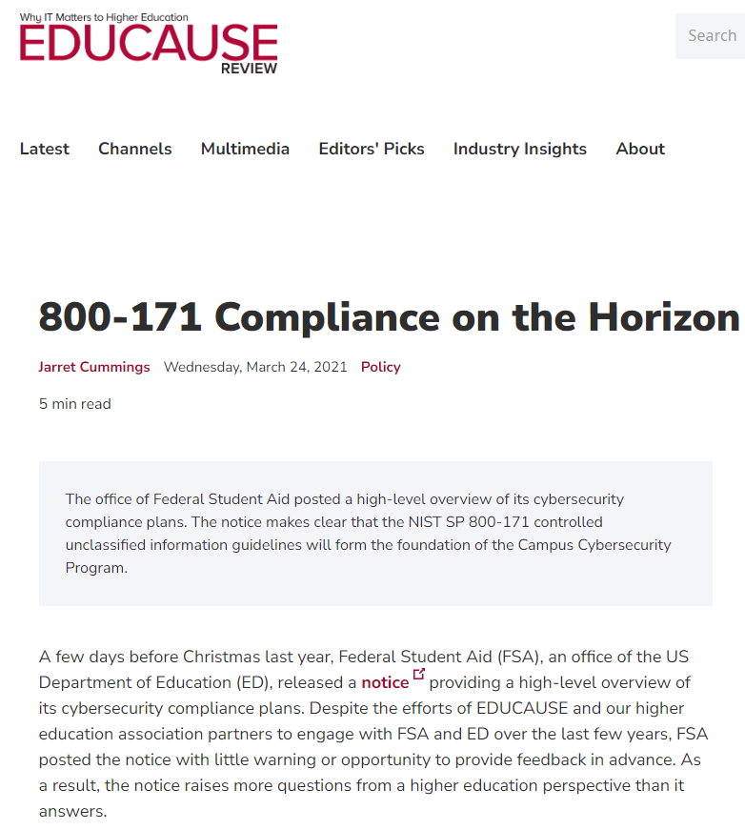
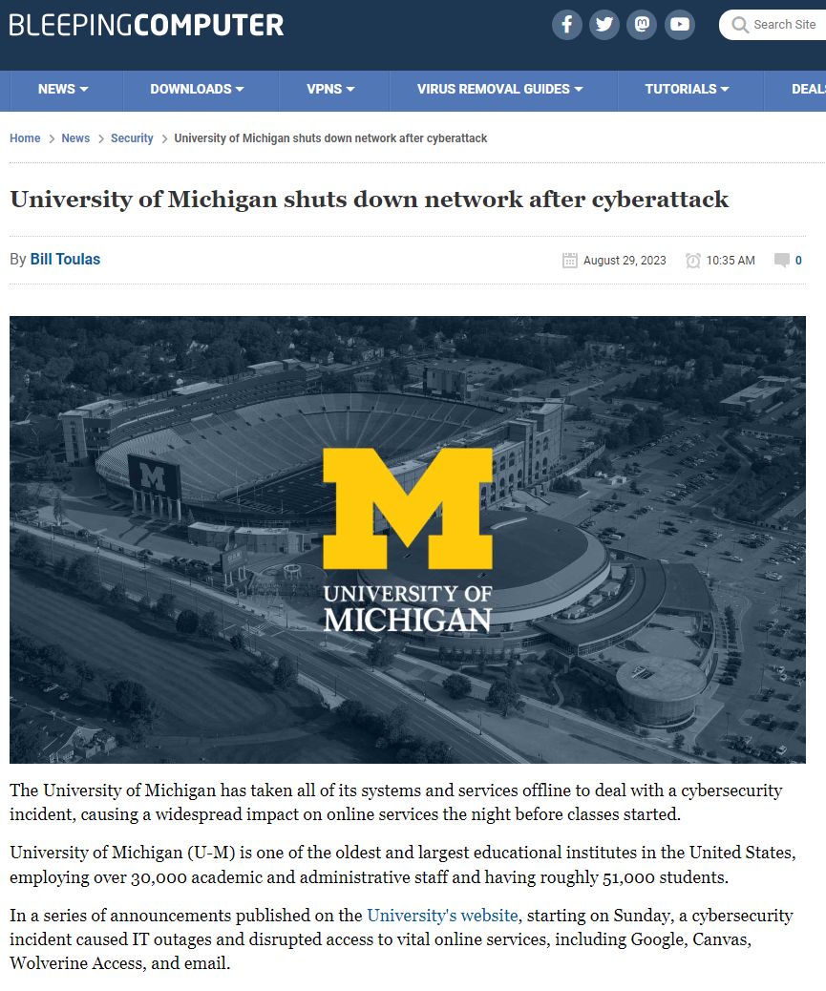
ITCC Subcommittees
  Cyber Security and NIST 800-171
    Goal of getting direction on how to manage the security concerns and compliance requirements but keep research productive. Determine how best to not become the next headline like Truman State and University of Michigan.
    This would include improving LAPS usability and other topics that may impact faculty.

Slide 32
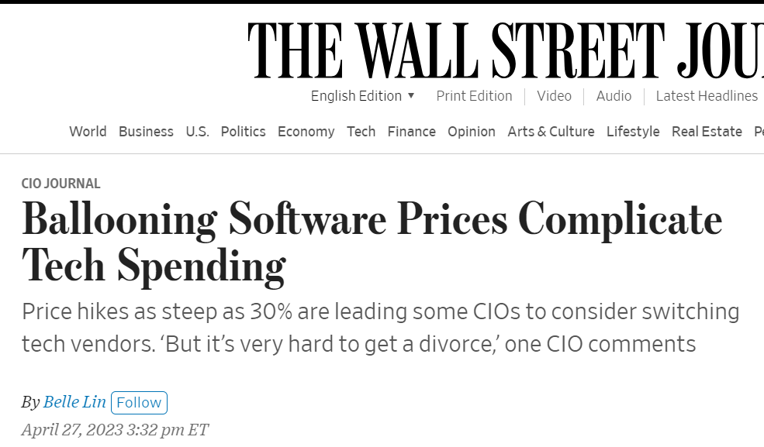
ITCC Subcommittees
  Academic and Research Software
    Goal of addressing diversification of the software portfolio, while balancing the increasing costs in software and cloud services, and single source concerns. Also recommend software that would help support faculty
    Example: Abaqus, Mathematica, Matlab, Overleaf…

Slide 33
ITCC Subcommittees
  Supported Environments
    Goal of discussing different environments.
    There is support Windows, with improving support for Mac, but Linux support is limited.
  Storage-Backup
    Goal of discussing local storage and cloud storage, and how they are impacted by Data Classification Levels and what is needed.
    Example: S:\, Y:\, and R:\ drives will be decommissioned in 2027 and we need to determine what the future of storage should look like.

Slide 34
ITCC Subcommittees
  Research Equipment
    Goal of discussing what types of services supporting research equipment the campus needs and should offer, and how best to educate faculty on what the vendor is not telling them.
    Most vendors support Windows 10 (end-of-life in 2025) but not Windows 11.
    Some vendors will void warranty if tampered with or reinstalled.
    Grant funding is varied.
    Developing separation of labs off the network but it requires hardware and dedicated staff. Need funding and a building of skills.

Slide 35
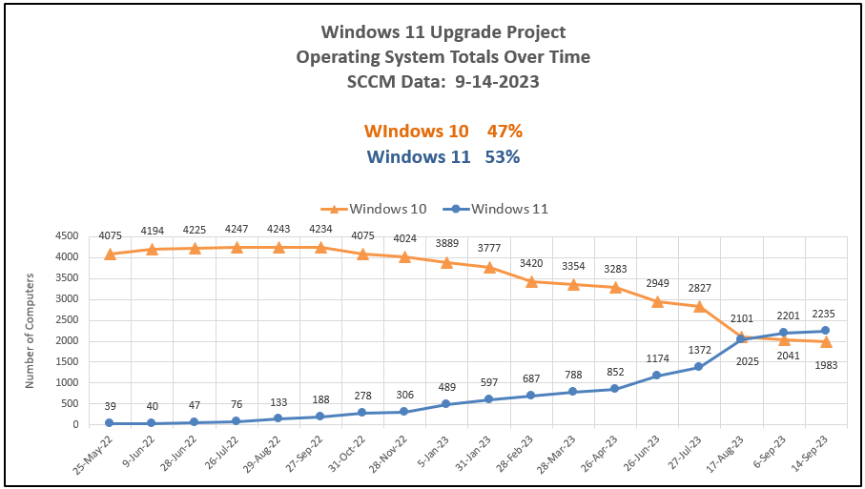
IT Update - Status of Windows 11 Armageddon
  Windows 11 Armageddon (October 2025)

Slide 36
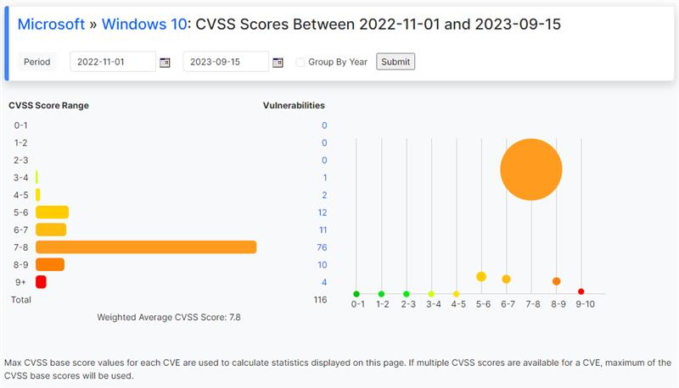
IT Update - Windows Upgrade Failure
  Windows 10 update caused the failure of 15% of computes on campus.
  They have been in a broken state since November of last year.
  The last of them are being addressed now by the end of the week.

Slide 37
IT Update
  W:\ drives are getting decommissioned at the end of the year.
  Computer Lifecycle Replacement program
    F&O Information Series presentation, October 17, 2023 on Zoom
  Non-employee accounts
    Issues with UM System account decommissioning automation not catching up with changes that has resulted in account lockouts.
    Please check on anyone who may have had a courtesy appointment Emeriti and adjuncts and let us know.
  Find information https://status.mst.edu and https://itanswers.mst.edu .

Slide 38
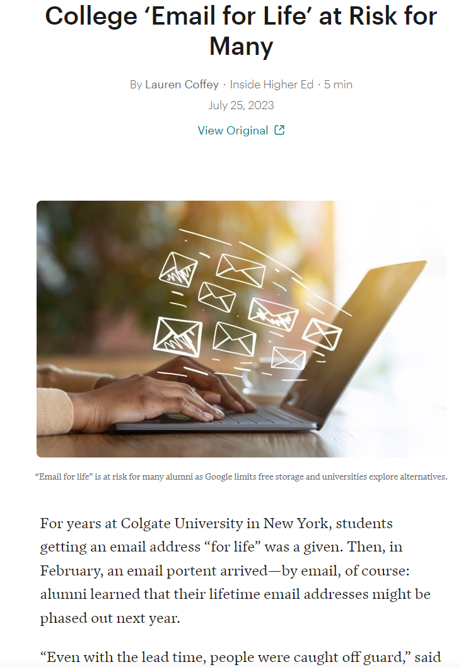
Impact of Account Decommissioning
  Decommissioning of alumni accounts
  https://www.insidehighered.com/news/tech-innovation/2023/07/25/college-email-life-risk-google-limits-free-storage
  Creates a problem with contacting alumnus, but also a concern about forwarding addresses.
  Social media like Linkedin, also used by prospective students.
  What if a forwarding directory existed?

Slide 39
VI. Reports of Standing Committees
      Budgetary Affairs
      M. Fitch

Slide 40
FY2023 Actuals - Operating Revenues
All University Funds (in millions)
Operating Revenues | FY2022 | FY2023 | $ ∆ | % ∆
Tuition and Fees | 120.0 | 126.0 | 6.0 | 5.0%
Less Scholarship Allowances | 71.2 | 70.8 | (0.4) | -0.5%
Net Tuition and Fees | 48.8 | 55.2 | 6.4 | 13.0%
Institutional Discount Rate | 59.3% | 56.2%
Federal Pell Grants | 5.4 | 5.6 | 0.1 | 2.5%
Government Scholarship Funding | 5.7 | 5.9 | 0.3 | 4.9%
Institutional CARES Act Funding | 14.3 | - | (14.3) | -100.0%
Grants and Contracts | 44.2 | 45.7 | 1.5 | 3.3%
Auxiliary Enterprises | 23.1 | 24.5 | 1.4 | 5.9%
Other Operating Revenues | 3.4 | 4.6 | 1.2 | 34.1%
State Appropriations | 53.0 | 55.9 | 2.9 | 5.5%
Private Gifts | 8.2 | 21.1 | 12.9 | 157.1%
Spendable Investment Income (Internal) | 18.5 | 14.3 | (4.2) | -22.7%
Total Operating Revenues | 224.7 | 232.8 | 8.0 | 3.6%
KF money

Slide 41
FY2023 Actuals - Operating Expenses
All University Funds (in millions)
Operating Expenses | FY2022 | FY2023 | $ ∆ | % ∆
Salaries and Wages | 96.0 | 105.7 | 9.7 | 10.1%
Benefits | 29.3 | 32.0 | 2.6 | 9.0%
Supplies, Services and Other Expenses | 45.1 | 52.3 | 7.2 | 16.0%
Depreciation | 23.9 | 23.6 | (0.3) | -1.3%
Interest Expense | 5.3 | 5.1 | (0.2) | -4.3%
Total Operating Expenses | 199.6 | 218.6 | 19.0 | 9.5%
Net Operating Income | 25.1 | 14.1
Net Operating Margin | 11.2% | 6.1%

Slide 42
FY2023 Actuals - Operating Revenues
Operating Funds (in millions)
Operating Revenues | FY2021 | FY2022 | FY2023 | $ ∆ | % ∆
Tuition and Fees | 119.5 | 120.0 | 126.0 | 6.0 | 5.0%
Less Scholarship Allowances | 36.7 | 38.7 | 43.6 | 4.9 | 12.6%
Net Tuition and Fees | 83.7 | 81.3 | 82.4 | 1.1 | 1.4%
Institutional Discount Rate | 31% | 32.3% | 34.6%
Auxiliary Enterprises | 0.7 | 1.2 | 1.4 | 0.3 | 22.5%
Other Operating Revenues |  | 10.5 | 12.7 | 2.2 | 21.4%
State Appropriations | 45.7 | 53.0 | 55.9 | 2.9 | 5.5%
Private Gifts | 0.5 | 0.4 | 0.5 | 0.1 | 11.6%
Spendable Investment Income | 1.9 | 3.4 | 3.6 | 0.2 | 4.6%
Total Operating Revenues | 140.2 | 149.9 | 156.6 | 6.7 | 4.5%
Discount up
Mostly F&A
State up a bit

Slide 43
FY2023 Actuals - Operating Expenses
Operating Funds (in millions)
Operating Expenses | FY2022 | FY2023 | $ ∆ | % ∆
Salaries and Wages | $ 77.0 | $ 82.6 | $ 5.6 | 7.3%
Benefits | 25.2 | 26.7 | 1.5 | 6.0%
Supplies, Services and Other Expenses | 25.7 | 25.8 | 0.2 | 0.6%
Total Operating Expenses | 127.9 | 135.1 | 7.3 | 5.7%
Net Operating Income | 22.0 | 21.5 | (0.5) | -2.4%
Net Operating Margin | 14.7% | 13.7%

Slide 44
FY2024 - Operating Revenues
Operating Funds (in millions)
Operating Revenues | FY2022 | FY2023 | FY2024
Tuition and Fees | 120.0 | 126.0 | 125.9
Less Scholarship Allowances | 38.7 | 43.6 | 43.6 ?
Net Tuition and Fees | 81.3 | 82.4 | 82.3
Institutional Discount Rate | 32.3% | 34.6% | 34.6%
Auxiliary Enterprises | 1.2 | 1.4 | 1.4 ?
Other Operating Revenues | 10.5 | 12.7 | 12.7?
State Appropriations | 53.0 | 55.9 | 60.0
Private Gifts | 0.4 | 0.5 | 0.5?
Spendable Investment Income | 3.4 | 3.6 | 3.6 ?
Total Operating Revenues | 149.9 | 156.6 | 156.6
Nonresident enrollment up
UG FTC Res +28
UG FTC Nonres +20
UG Trsfr Res +7
UG Trsfr Nonres +10
UG cont Res -171
UG cont Nonres +94
-12
MS +140
PhD +12
Distance -73
FLW 15
MSU +24
State up a bit

Slide 45
Raises
“Raise” includes
  raise,
  merit,
  market,
  counter-offer, and
  temporary pay increase (e.g. Dep’t Chair, almost always lost at end of service)
  Excludes
  promotion (Prof $10K, Teach Prof $6K, Assoc Prof $5K, Assoc Teach Prof $3K)

Slide 46
Notes and Oddities
  Admin = Chancellor and Provost and direct reports, as positions
  Exclude retiree continuing pay (e.g. Chancellor’s prof = 1/3 previous)
  Market and merit increases unusual pre-2020, now common (base raise was ‘raise’, remainder was ‘market’ or ‘merit’)
  Counteroffers and move to administration dominate high increases
  Allegedly 4% raise pool as 3 base + 1 merit, but arithmetic shows
  total faculty salary increase ~2.4%, average ‘raise’ percentage = 5.94%

Slide 47
Chancellor positions
Position | AY 23-24 |  | AY 22-23 |  | AY 21-22 |  | AY 20-21
Chancellor | Dehghani | +11% | Dehghani | +10% | Dehghani | +15% | Dehghani | +11%
Provost | Potts | +3.0 | Potts | +3.3 | Potts | +41.2 | Roberts | +1.7
VC R | Khayat | +6.7 | Khayat (i) | +3.4 | Khayat | +18.3 | Tsatsoulis | 0.0
VC Adv | Verkamp (i) | +5.0 | Verkamp (i) | -31.3 | Nesbitt | +3.7 | Nesbitt | 0.0
VC F&O | O’Neil | +16.4 | O’Neil | +4.9 | O’Neil | +7.0 | Plain | 0.0
VC SA | Robinson | +3.0 | Robinson | +3.5 | Robinson | +2.9 | Robinson | 0.0
VC (KI) | Roberts | +0.0 | Roberts | +3.0 | Roberts | +100
CDO | Roberson | +2.0 | Roberson | +105 | Rivera² | -20.6 | Rivera²/Outar | -9.0
VC Mkt | Cain | +100
 |  |  | Careaga¹ | +3.6 | Careaga | +15 | Careaga | +16.1
SUM | $2,715,076 | +7.7 | $2,521,112 | +5.5 | $2,390,181 | +29.9 | $1,840,622 | +3.0
¹Official title Director II
+ 2.4 total Faculty Salary

Slide 48
Provost positions
Position | AY 22-23 (15) |  | AY 22-23 (13) |  | AY 21-22 (12) |  | AY 20-21 (11)
Provost | Potts | +3.4 | Potts | +3.4 | Potts | +41.2 | Roberts (i)
CEC Dean | Borrok | +39.9 | Borrok (i) | -27.3 | Wlezien | 0.0 | Wlezien
CASE Dean | Boroujerdi | +3.0 | Boroujerdi | +36.8 | Drowne (i) | +0.5 | Drowne (i)
KC Dean | Faley (i) | +34.6 | Murray (i) | +100
Dep Prov^{a,b} |  |  | Brow | +0.2 | Brow | +0.9 | Brow
VP Enroll | Spivey | +44.5 | Spivey | -27.3 | Sivadasan | +2.1 | Sivadasan
VP US | Reardon | +40.1 | Reardon | -21.5 | Northcut | +1.6 | Northcut (i)
VP Ed Inno |  |  | Concepcion | +3.9 | Concepcion | +100
VP Onl Ed | Murray | +100
VP GE | Frimpong | +46.6 | Glaser | -43.6 | Tsatsoulis | +100
VP Int’l Af |  |  |  | -100 | Hofer | +0.6 | Hofer
AVC (CIRO) | Jones | +6.1 | Jones | +8.3 | Jones | 0.0 | Jones
Dean Lib | Gerlich | +100
AP Admin |  |  |  |  |  | -100 | Moore
AP Fac Af^{a,b} | Forciniti | +0.7 | Forciniti | +5.3 | Forciniti | +1.0 | Forciniti
Spec Asst^{a,b} | Drowne | -15.4 | Drowne | +138 | Stone | +1.2 | Stone
AP Ac Op^{b} | Raper | +38 | Raper | +100
Ombuds | Sedigh Sarvestani | +100
SUM | $2,922,614 | +29.7 | $2,253,819 | +0.16 | $2,250,301 | +20.4 | $1,869,750

Slide 49
Faculty*
*not including Lecturers, Research NTT, Chancellor’s profs, or most administrators
Arithmetic of 3 + 1%, if six faculty each $100/yr, $24 raise pool (18 + 6):
a, b, c, d get $2, $2.5, $3, $3.5 (= $11)
e gets $6 = 3.5 + 2.5
f gets $7 = 3.5 + 3.5
  AY 2023-2024
  Most dept’s had two raise groupings
    2-4%, 6-10% (merit, etc.): GGPE, MSE, Math
    2-3, 5-10+: EMSE, MNE, BIT, Econ
    1-4, 5-10+: ECE, CArE, NERS
    1-3, 5-10: ChE, CS
    0-3, 4-8: MAE
    3-4.2, 5-15: Bio Sci, Psych
    3, 5-10+: Chem
    2, 3-5, 6+ ETC but equity dominated
  No grouping discerned: ALP, Psych, Physics, TEC
  Faculty range wide (charts about to happen)
  AY 2022-2023
  Most dept’s had two raise groupings = 2-4 %, 6-10% (merit, etc.): ECE, EMSE, MSE, MNE, NERdS, TEC, Math
  Or lower ~0-3%, 5-10%: ChE, CArE, CS, GGPE, Physics, Hist, ETC
  No grouping discerned: MAE, Psych, Bio Sci
  3.0%, 7-10%: Chem, BIT, ALP
  AY 2021-2022
  Dep’ts varied, 1.13 – 5.74% raise, two groupings = 2.0-2.6 % and 3.3-3.5%

Slide 50
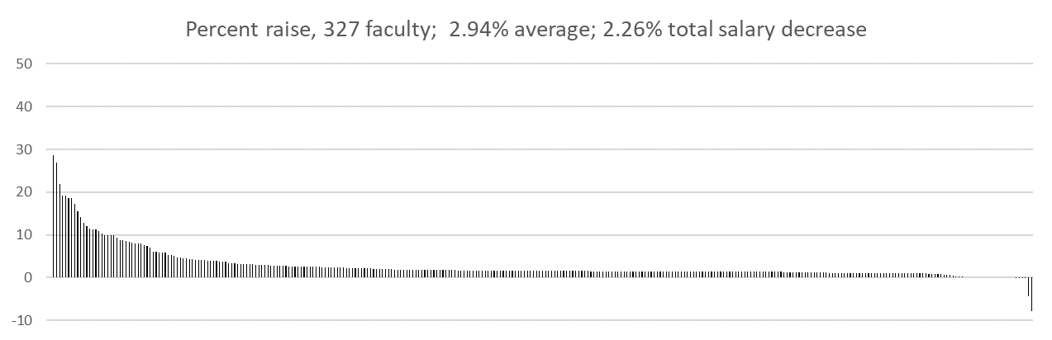
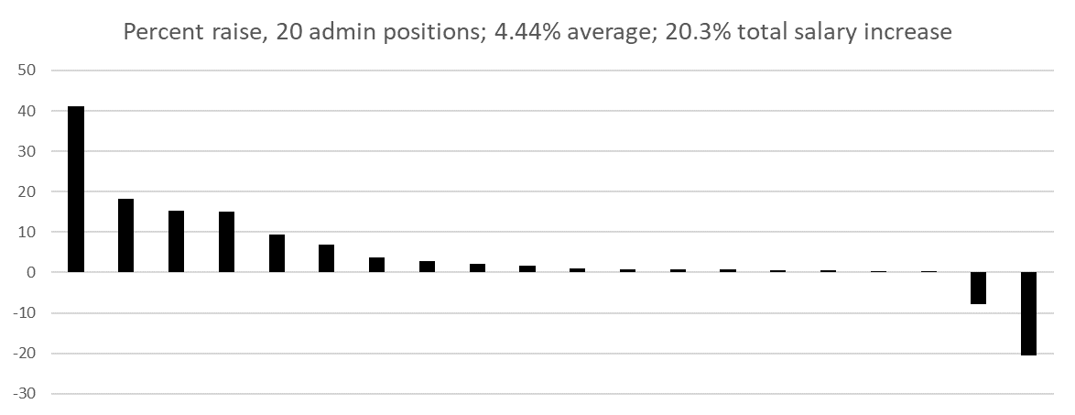
AY 21-22

Slide 51
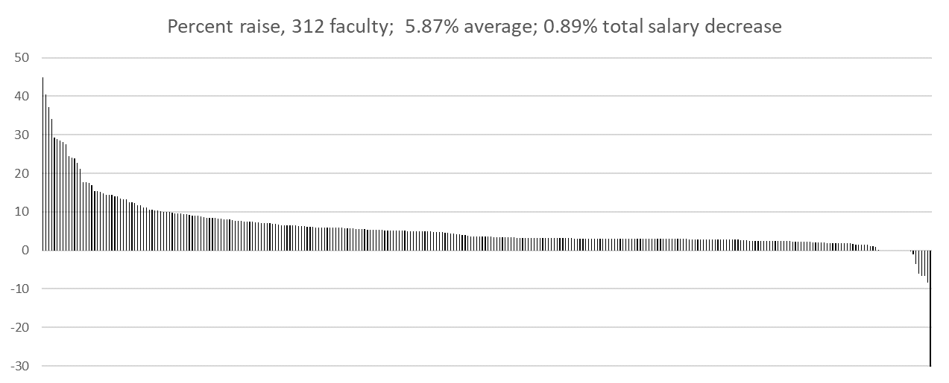
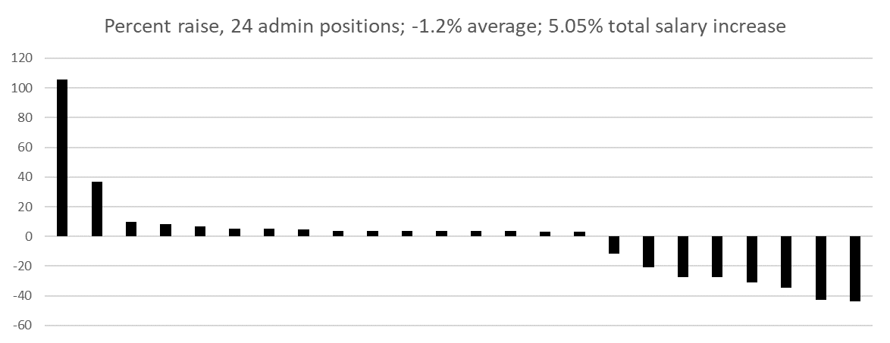
AY 22-23
(Last year)
Each bar is one person
>15% are counteroffers and admin
(except one person)
Added VP&D KC
Added AVC IEC
Added AP AOAA
Deleted AVP IA
Deleted DepP (to SpAsst)
*
*
*
*
*
*
*
*
*
*
* Change in person

Slide 52
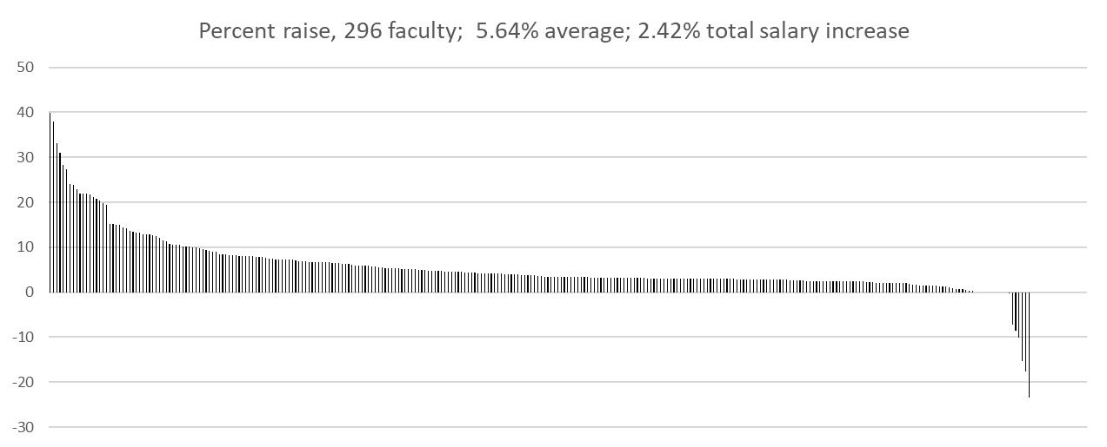
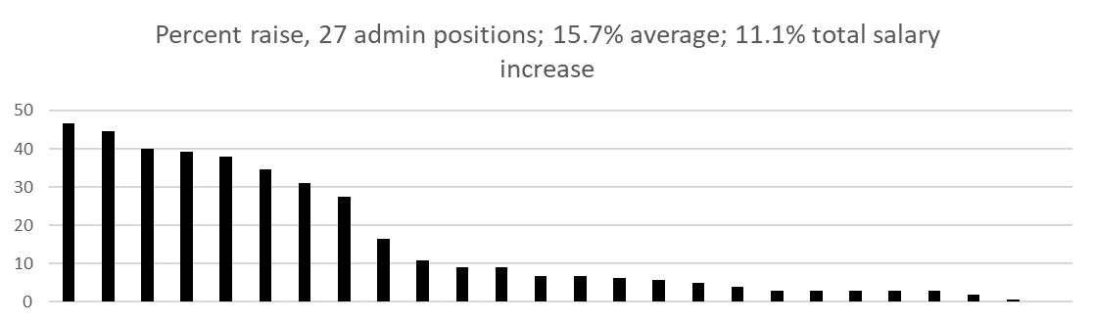
AY 23-24
>0% are left admin
>20% are counteroffers and admin
(except one person)
Admin:
“chancellor”
“provost”
CIO
Not
Dean of Library
Ombudsman
Special Assistants
KC Dean
* Change in person
# Interim to permanent
*
#
#
*
Added VC Mkt
Added VP OL
Deleted VP GL
Deleted Sp Asst?
*

Slide 53
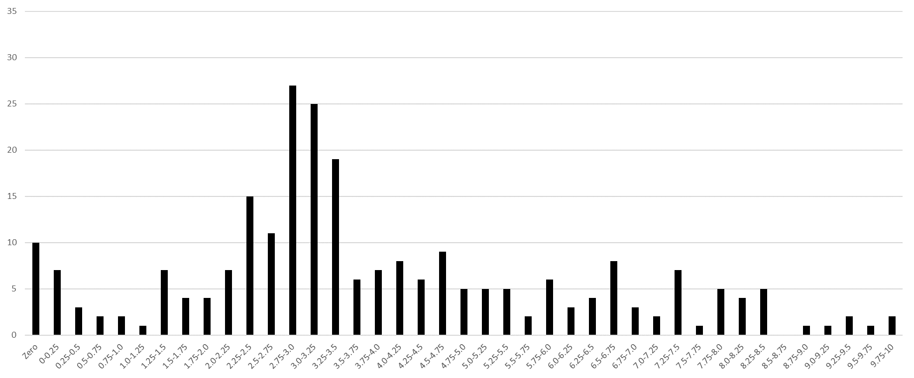
Faculty number per ¼ percent bin
Not shown: 7 faculty from admin with negative salary increases
2.0% or less,
40 faculty
2.0% - 4.0%,
117 faculty
4% or more,
155 faculty
To increase salary >10%:
Become an administrator (11)
Get an offer somewhere else (12)
Equity raise for low pay (4)
Equity (1)
Market (8)
Just a raise (8)
10+%
44
3% ‘raise’
1% ‘merit’

Slide 54
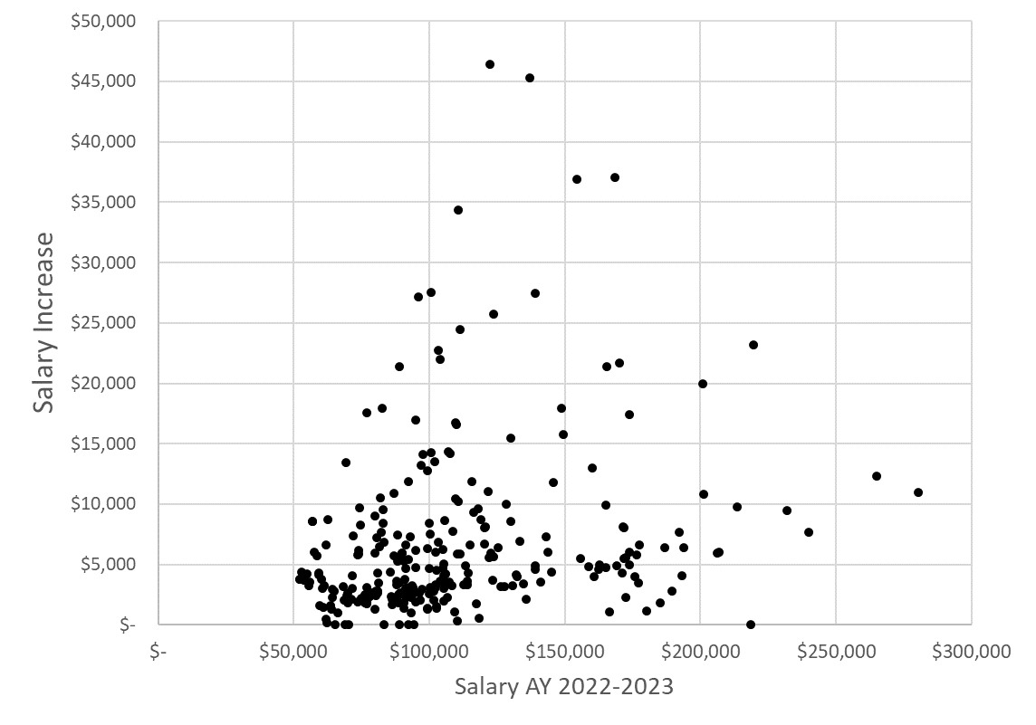
4%
3%

Slide 55
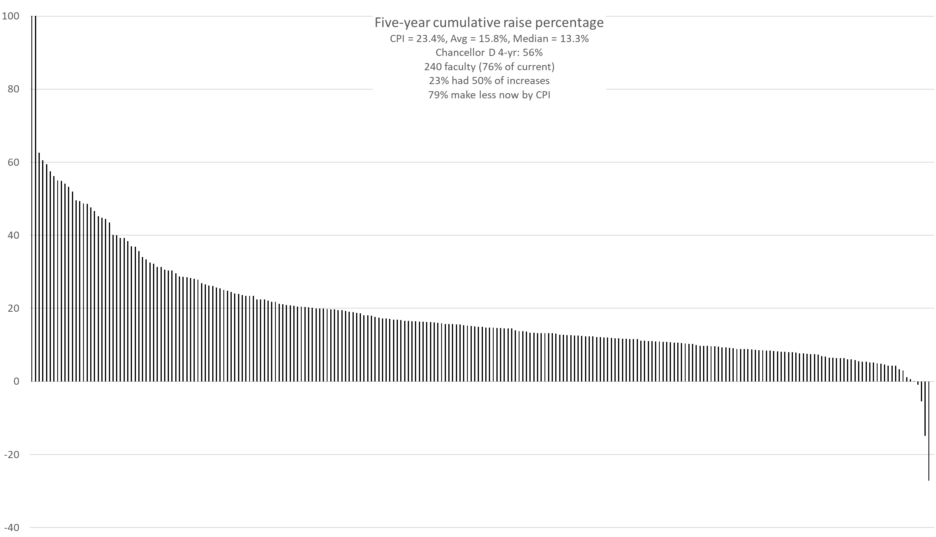
13 over 50%, 11 shift to Admin
CPI
Below 0, shift from admin

Slide 56
AY 23-24 Average %
*Did not include Lecturers, Research NTT, Chancellor’s profs, or administrators in numbers
Department
Hist & PS
GGPE
Psych
Chem
Bio Sci
Math
EMSE
ALP
BIT
TEC
ECE
4
5
CS
0
1
2
3
MAE
ChE
6
7
8
MSE
Econ
NERdS
MinE
CArE
Physics
Engl &TC
Hist & PS 1.21 BIT 5.28
MSE 3.46 NERdS 5.73
MAE 3.82 CS 5.98
Psych 3.87 TEC 5.99
GGPE 3.87 Engl & TC 6.03
Physics 3.89 Math 6.14
Chem 4.29 ECE 6.26
ChE 4.49 MinE 6.81
Bio Sci 5.10 EMSE 7.26
Econ 5.14 CArE 7.45
ALP 8.02

Slide 57
AY 22-23
*Did not include Lecturers, Research NTT, Chancellor’s profs, or administrators in numbers
Department
MAE
GGPE
Engl &TC
Psych
Econ
ALP
Chem
Bio Sci
Math
EMSE
CArE
CS
0
1
2
3
4
5
ChE
6
7
8
ECE
BIT
MSE
NERdS
MinE
TEC
Hist & PS
Physics
Econ 2.58 MSE 5.94
ALP 4 Math 6.14
Chem 4.29 NERdS 6.39
BIT 4.99 EMSE 7.1
MAE 5.03 MinE 7.15
Hist & PS 5.09 CS 7.4
Bio Sci 5.1 Psych 7.92
Physics 5.26 GGPE 8.11
TEC 5.26 CArE 8.15
ChE 5.26 ECE 8.18
Engl & TC 5.27

Slide 58
AY 21-22
*Did not include Lecturers, Research NTT, Chancellor’s profs, or administrators in numbers
Department
Psych
Engl &TC
Bio Sci
Math
MAE
EMSE
MSE
NucE
Econ
CArE
CS
TEC
ChE
ALP
1
2
ECE
3
4
5
6
0
Chem
GGPE
Physics
MinE
Hist & PS
BIT
Econ 1.29 CS 3.14
Engl & TC 2.01 GGPE 3.25
Physics 2.04 EMSE 3.34
MAE 2.16 Hist & PS 3.39
Chem 2.38 BIT 3.40
CArE 2.41 Math 3.41
ECE 2.48 TEC 3.54
Psych 2.50 MSE 3.98
Bio Sci 2.57 Che 5.51
MinE 2.57 NucE 5.74
ALP 2.61
ChE 3.0% w/o counter offer
NucE 4.6% w/o aTP to aP
MSE 3.3% w/o counter offer

Slide 59
Trend?
Nope
Engl &TC
Bio Sci
Math
Econ
MAE
CArE
EMSE
MSE
NucE
ALP
CS
TEC
ChE
0
1
2
ECE
3
4
5
6
Physics
Chem
GGPE
MinE
Hist & PS
BIT
MAE
Engl &TC
GGPE
Econ
Chem
Bio Sci
Math
EMSE
Psych
CArE
ALP
CS
0
1
2
3
4
5
ChE
6
7
8
ECE
BIT
MSE
NERdS
MinE
TEC
Hist & PS
Physics
Hist & PS
GGPE
Psych
Chem
Bio Sci
Math
EMSE
ALP
BIT
TEC
ECE
4
5
CS
0
1
2
3
MAE
ChE
6
7
8
MSE
Econ
NERdS
MinE
CArE
Physics
Engl &TC

Slide 60
AY 23-24 Sum of Salaries Change %
*Did not include Lecturers, Research NTT, Chancellor’s profs, or most administrators in numbers
Department
Physics
Bio Sci
EMSE
MinE
Hist & PS
Chem
CS
ChE
MAE
Math
MSE
-20
-15
-10
-5
0
5
+10
+15
+20
Econ
NERdS
Psych
BIT
CArE
ALP
TEC
ECE
Engl &TC
GGPE
Faculty Count
CS +2 GGPE 0
Hist & PS +1 Math 0
TEC +1 CArE -1
MSE +1 Bio Sci -1
Econ +1 BIT -1
MAE +1 EMSE -1
Chem +1 Engl & TC -1
ALP 0 Psych -1
ChE 0 MinE -1
ECE 0 NERdS -1
Physics -3
Physics -12.2 ALP 4.2
Bio Sci -7.9 MinE 4.9
NERdS -7.8 GGPE 5.1
Psych -3.7 Math 5.5
Engl & TC -1.3 TEC 6.9
ChE -1.3 Hist & PS 7.0
MAE +0.2 MSE 7.1
BIT 1.6 ECE 7.2
EMSE 2.3 Chem 16.7
CArE 3.2 Econ 24.7 CS 30.0

Slide 61
317 Faculty*
*Did not include Lecturers, Research NTT, Chancellor’s profs, or administrators in numbers
Nor 5 faculty joining later this year
Dept | ALP | Bio | BIT | Chm | ChE | CArE | CS | Econ | ECE | EMSE | Engl & TC | GGPE | Hist | Math | MSE | MAE | MNE | NE | Phys | Psych | TEC
Net | -6 | +1 | -4 | -7 | -5 | -3 | -1 | -3 | -5 | -4 | +0 | -5 | -2 | -5 | -1 | -6 | -1 | -2 | -7 | -2 | +3
’18 | 20 | 11 | 18 | 24 | 16 | 28 | 16 | 9 | 36 | 16 | 18 | 22 | 13 | 24 | 20 | 40 | 9 | 8 | 19 | 12 | 2
’19 | 18 | 10 | 17 | 21 | 15 | 29 | 17 | 7 | 34 | 17 | 18 | 22 | 13 | 22 | 19 | 33 | 9 | 9 | 16 | 11 | 3
‘20 | 16 | 11 | 16 | 18 | 15 | 29 | 20 | 7 | 32 | 15 | 17 | 20 | 13 | 21 | 18 | 34 | 8 | 6 | 16 | 12 | 4
’21 | 16 | 12 | 14 | 16 | 12 | 26 | 19 | 6 | 31 | 14 | 19 | 19 | 12 | 20 | 18 | 33 | 8 | 6 | 17 | 12 | 4
‘22 | 14 | 13 | 15 | 16 | 11 | 26 | 13 | 5 | 31 | 13 | 19 | 17 | 10 | 19 | 17 | 33 | 9 | 7 | 15 | 11 | 4
‘23 | 14 | 12 | 14 | 17 | 11 | 25 | 15 | 6 | 31 | 12 | 18 | 17 | 11 | 19 | 19 | 34 | 8 | 6 | 12 | 10 | 5
2018-19 AY, 381 faculty, 64 fewer now (-17%)
2022-23 AY, 320 faculty, 3 fewer now ( -1%)

Slide 62
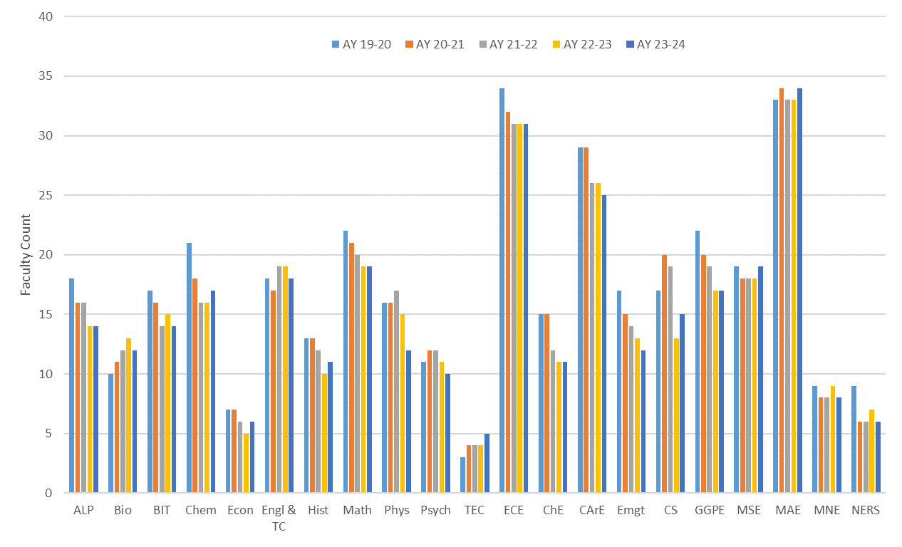
Faculty headcount
360 348 337 321 317 (~3.2% fewer per year)

Slide 63
VII. New Business

Slide 64
Faculty Senate
Fall Elections

Slide 65
Faculty Senate Secretary
The Secretary is responsible for all records, minutes, resolutions, and correspondence of the Faculty Senate. The Secretary supervises the publications of the agenda and the minutes of the meetings. The minutes shall be distributed by the Secretary of the Faculty Senate to all members of the General Faculty within ten (10) school days after the meeting.
Will join probable officer rotation to President-Elect, President, Past-President.

Slide 66
Nominees
Paul Runnion, Math

Slide 67
Budgetary Affairs
Standing Committee
Need 1 faculty member to replace Jonathan Kimball, whose term ends 2024.
Nominees:

Slide 68
Conflict of Interest Committee
Special Committee
Special Committees addressing issues not presently in the purview of the Faculty Standing Committees or Judicial Committees may be authorized as needed by the Chancellor, the General Faculty, the Faculty Senate, the colleges, or departments. However, when the faculty or the administration establishes any committee having campus-wide responsibilities or authority, they shall file with the Secretary of the Faculty Senate a statement specifying the responsibilities, authority, and composition of the committee, timeline of authority for the committee, together with a list of current members.
When deemed appropriate by the Chancellor, by the General Faculty, or by the Faculty Senate reports of Special Committees shall be distributed to all members of the General Faculty. Each Special Committee shall prepare an annual report to be made available to all faculty members.
Whenever possible, Special Committees shall be organized prior to September 1 and be responsible for their duties from August 1 through July 31 of the following year.

Slide 69
Conflict of Interest Committee
Special Committee
3 tenured faculty members will be chosen, 2 to serve 2-year terms and 1 to serve a 1-year term
Nominees:
  Haiming Wen, MSE
  Amitava Choudhury, Chem
  Levant Acar, ECE
  Jianmin Wang, CArE

Slide 70
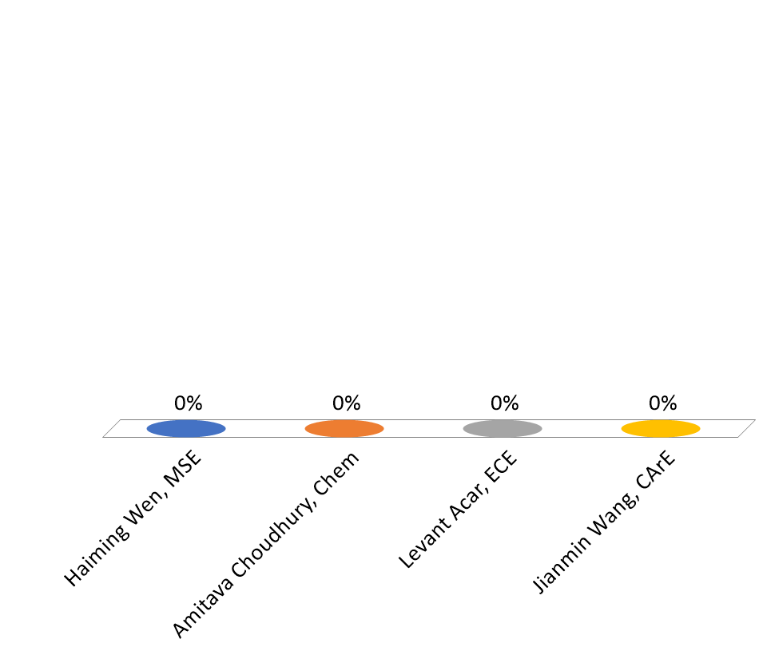
Conflict of Interest Committee - Special Committee
3 tenured faculty members will be chosen, 2 to serve 2-year terms and 1 to serve a 1-year term
Haiming Wen, MSE
Amitava Choudhury, Chem
Levant Acar, ECE
Jianmin Wang, CArE

Slide 71
Grievance Oversight Committee
Judicial Committee
A member of the OC will be appointed to each grievance case following receipt of a Grievance Filing Form by the GRP. The OC representatives are observers of the confidential grievance processes: The OC representative may not participate in the deliberations or rendering of findings and recommendations by the GRP but provides a summative, evaluative report of each grievance process without conveying substantive information. The representatives also monitor the implementation of remedies that result from a grievance process.
Each faculty member serves a three-year term, but terns are to be staggered; Admin Rep serves a three-year term

Slide 72
Grievance Oversight Committee
Judicial Committee
2 faculty members will be chosen, 1 to serve a 3-year term and 1 to serve a 2-year term
Nominees:
  Cihan Dagli, EMSE
  Rainer Glaser, Chem
  Ali Hurson, ECE
  Grace Yan, CArE

Slide 73
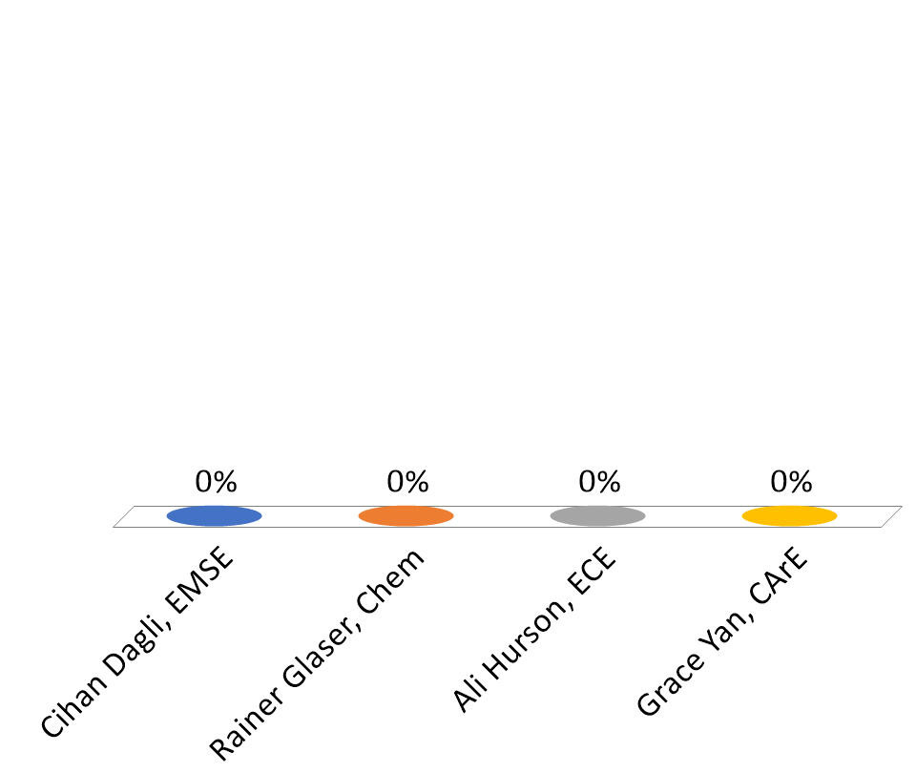
Grievance Oversight Committee - Judicial Committee
2 faculty members will be chosen, 1 to serve a 3-year term and 1 to serve a 2-year term
Cihan Dagli, EMSE
Rainer Glaser, Chem
Ali Hurson, ECE
Grace Yan, CArE

Slide 74
Parking, Security and Traffic Committee
Judicial Committee
The committee oversees application of rules and regulations concerning parking and traffic. It functions according to the principles stated in The Curators of the University of Missouri Collected Rules and Regulations.

Slide 75
Parking, Security and Traffic Committee
Judicial Committee
8 faculty members will be chosen, 4 to serve 2-year terms and 4 to serve a 1-year term.
Nominees:
  Petra DeWitt, Hist/PoliSci
  Michel Gueldry, ALP
  Risheng Wang, Chem
  Pourya Shamsi, ECE
  Weibing Gong, GGPE
  John Myers, CArE
  Meggie Wen, Math/Stat

Slide 76
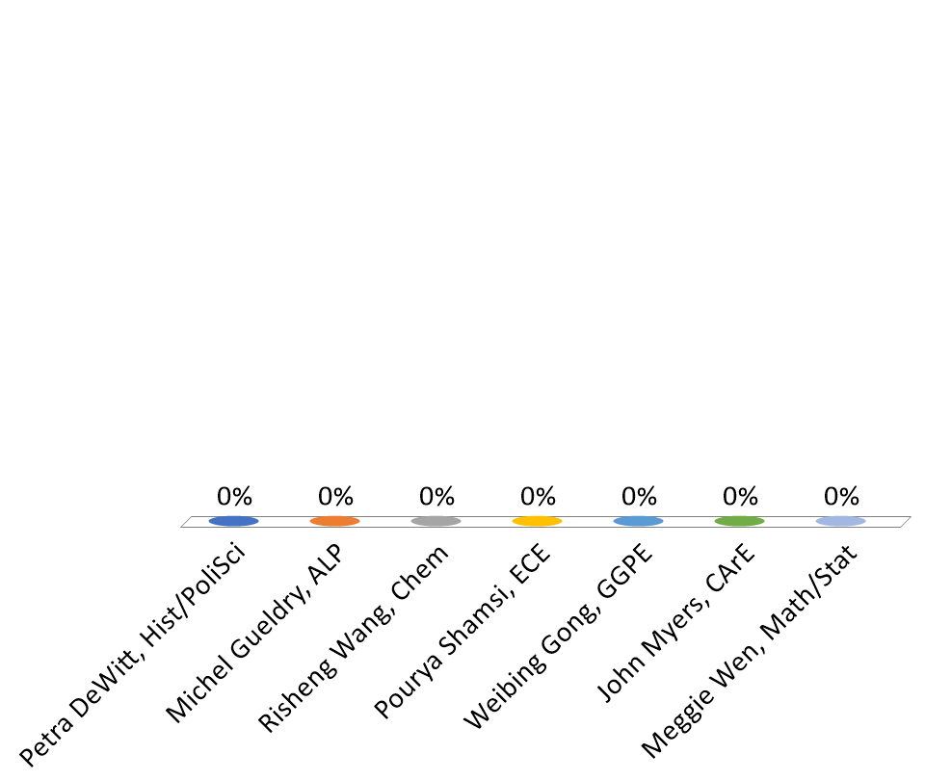
Parking, Security and Traffic Committee - Judicial Committee
8 faculty members will be chosen, 4 to serve 2-year terms and 4 to serve a 1-year term
Petra DeWitt, Hist/PoliSci
Michel Gueldry, ALP
Risheng Wang, Chem
Pourya Shamsi, ECE
Weibing Gong, GGPE
John Myers, CArE
Meggie Wen, Math/Stat

Slide 77
Student Scholastic Appeals Committee
Judicial Committee
This committee establishes procedures for individual student scholastic appeals. The committee shall consider and rule on all individual cases of appeal relating to student scholastic performance, including but not limited to: graduation with honors, probation and dropping from school, readmission after being dropped for scholastic reasons, scholastic deficiencies and evaluation of credit and transfer of credits, grades and honor points from other campuses to Missouri S&T. It serves as an appeal board for cases of students on scholastic probation who are involved in the activities of organizations.

Slide 78
Student Scholastic Appeals Committee
Judicial Committee
5 faculty members will be chosen, 3 from and by Faculty Senate and 2 from and by Gen Fac. Each will serve 2 year terms.
Nominees:
  Aditya Kumar, MSE
  Jeffrey Winiarz, Chem
  Zhi Lang, M&AE
  Kurt Kosbar, ECE
  Genda Chen, CArE
  CJ Lungstrum, Math/Stat

Slide 79
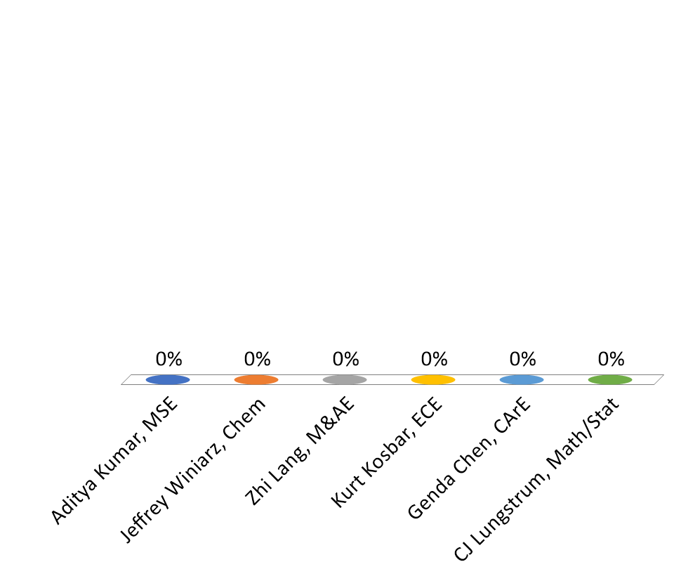
Student Scholastic Appeals Committee - Judicial Committee
5 faculty members will be chosen, 3 from and by Faculty Senate and 2 from and by Gen Fac. Each will serve 2 year terms
Aditya Kumar, MSE
Jeffrey Winiarz, Chem
Zhi Lang, M&AE
Kurt Kosbar, ECE
Genda Chen, CArE
CJ Lungstrum, Math/Stat

Slide 80
Grievance Hearing Panel Committee
Judicial Committee
This panel is concerned with the fair and equitable resolutions of faculty grievances with the University. It functions according to the principles stated in the Academic Grievance Procedure (section 370.010) adopted by the University of Missouri Board of Curators. It may also make recommendations for policy changes through the Faculty Senate to the Board of Curators.
One (1) panel or two (2) panels of two (2) faculty members are elected by the Faculty Senate from nominations from academic departments to three years renewable terms on a rotational schedule. Whether one (1) or two (2) panels are populated is subject to determination by majority vote of the Faculty Senate.
We need two votes:
  Who will serve: vote for 2
  Do we want 1 or 2 panels

Slide 81
Grievance Hearing Panel Committee
Judicial Committee
Do we want 1 or 2 panels?

Slide 82
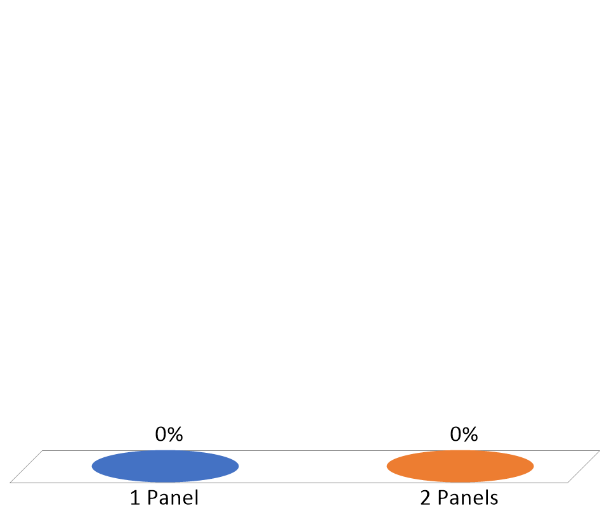
Grievance Hearing Panel Committee - Judicial Committee
Do we want 1 or 2 panels?
1 Panel
2 Panels

Slide 83
Grievance Hearing Panel Committee
Judicial Committee
Nominees: 1 will serve 3 years, 1 will serve 1 year
Bruening, Michael | History and Political Science
Chen, Genda | CArE
Stanley, Joe | ECE
Alexander, Julia | Education
Alagha, Lana | M&EE
Gueldry, Michel | ALP

Slide 84
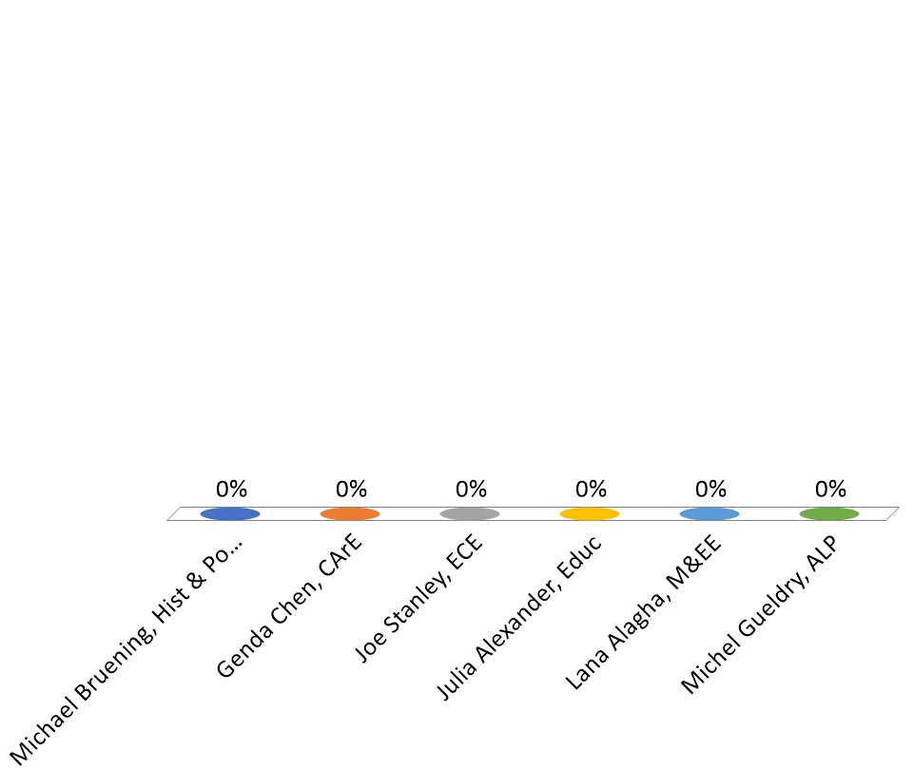
Grievance Hearing Panel Committee - Judicial Committee
Nominees: 1 will serve 3 years, 1 will serve 1 year
Michael Bruening, Hist & Poli Sci
Genda Chen, CArE
Joe Stanley, ECE
Julia Alexander, Educ
Lana Alagha, M&EE
Michel Gueldry, ALP

Slide 85
VIII. Adjourn

